Slide 1

Advanced APIs

Slide 2
Content
In this lecture we will learn:
What application protocols are;
What the HTTP protocol is;
The HTTP request response cycle;
How to make requests to web servers.

Slide 3
Application Protocols
1

Slide 4
Application Protocols
A protocol is a system of rules that specifies how two entities can communicate with each other and how information flows from one entity to another one. As such, a protocol outlines the rules regarding syntax, semantics as well as other communication-related aspects.

Slide 5
Application Protocols
By analogy, we can understand a protocol as the rules mediating a postal transaction: in order to successfully send a postcard, you need a stamp and a valid address.
📯
🏢
📮
🚚
🏡
✉

Slide 6
HTTP Protocol
2

Slide 7
HTTP: Introduction
HTTP (HyperText Transfer Protocol) is a protocol that outlines the interaction between server and client.
For instance, you pay with your VISA online, the transaction travels via secure HTTP communication known as HTTPS.
HTTP is also the protocol chosen in applications that range from synchronizing traffic lights in a city to receiving a video when you visit Youtube.

Slide 8

HTTP: Introduction
Request
💻
Client
Server
Response

Slide 9
HTTP: Request-Response Cycle
In most cases, there is back-and-forth of REQUEST and RESPONSE which is known as the Request-Response Cycle.
If both parties (CLIENT and SERVER) can communicate they should be able to complete this cycle.
There are corner cases. For example, when the CLIENT cannot send a question to the SERVER because it’s offline.

Slide 10
HTTP: Request-Response Cycle
📤
Request
💻
Client
Server
📦
Response

Slide 11
HTTP Protocol: URL
3

Slide 12
HTTP: URL
The URL (uniform resource locator) is an important part of the protocol. It contains information regarding the specific resource we are requesting from the SERVER.
It follows the following format:
scheme:[//authority]path[?query][#fragment]
Notes:
https://upload.wikimedia.org/wikipedia/commons/0/06/Query_string.png

Slide 13
HTTP: URL
https://www.youtube.com/results?search_query=ironhack
Scheme: In this case it's https.
Authority: In this case www.youtube.com this is the server we are connecting to.
Path: Path to the resource. In this case ‘results’.
Query String: Essentially narrows down the search. Here we search for ‘ironhack’.
Fragment: Contains secondary information. For instance, it may direct to a specific header in the HTML file.
Notes:
https://upload.wikimedia.org/wikipedia/commons/0/06/Query_string.png
http://www.phoneshop.com?product=iphone&size=32gb&color=white

Slide 14
HTTP: URL
https://docs.google.com/presentation/d/1UwsLUWhAugbCy_Pi1CS_wmfZR5G6BRbT/edit#slide=id.g7df4486f2a_0_9
Scheme: In this case it's https.
Authority: In this case www.docs.google.com this is the server we are connecting to.
Path: Path to the resource. In this case /presentation/d/1UwsLUWhAugbCy_Pi1CS_wmfZR5G6BRbT/.
Query String: Essentially narrows down the search.
Fragment: Contains secondary information. For instance, it may direct to a specific header in the HTML file. Here it refers to a slide #slide=id.g7df4486f2a_0_9.
Notes:
https://upload.wikimedia.org/wikipedia/commons/0/06/Query_string.png

Slide 15
Requests
4

Slide 16
Requests: Introduction
The REQUEST is a question we formulate to a SERVER in order to receive a piece of information.
This piece of information can be anything: it is not defined in the HTTP standard what information the SERVER should answer with. It can be anything: an image, a video, a HTML page, a PDF file, etc.

Slide 17
Requests: Introduction
Request
GET /python/python_loops.htm HTTP/1.1
User-Agent: Mozilla/4.0 (compatible; MSIE5.01; Windows NT)
Host: www.tutorialspoint.com
Accept-Language: en-us
Accept-Encoding: gzip, deflate
Connection: Keep-Alive
💻
Client
Server

Slide 18
Requests: Syntax
Verb Part
GET /python/python_loops.htm HTTP/1.1
User-Agent: Mozilla/4.0 (compatible; MSIE5.01; Windows NT)
Host: www.tutorialspoint.com
Accept-Language: en-us
Accept-Encoding: gzip, deflate
Connection: Keep-Alive
Header

Slide 19
Requests: Syntax
Method
Path
HTTP version
GET /python/python_loops.htm HTTP/1.1
User-Agent: Mozilla/4.0 (compatible; MSIE5.01; Windows NT)
Host: www.tutorialspoint.com
Accept-Language: en-us
Accept-Encoding: gzip, deflate
Connection: Keep-Alive

Slide 20
Requests: HTTP Methods
There are two types of methods:
GET: Request for a specific piece of information.
POST: Request for an update from the server and posts information to the server:
POST /timeline HTTP/1.1
Host: www.twitter.com
User-Agent: Mozilla/5.0 (Macintosh; Intel Mac OS X 10_14_2) Chrome/71.0.3578.98 Safari/537.36
Accept: text/htm
Accept-Language: en,es
username=ironhack

Slide 21
Response
5

Slide 22
After Break Recap
Request
💻
Client
Server
Response

Slide 23
Response: Introduction
💻
Hello world!
Server
Client
Response
HTTP/1.1 200 OK
Date: Sun, 10 Oct 2010 23:26:07 GMT
Server: Apache/2.2.8 (Ubuntu) mod_ssl/2.2.8 OpenSSL/0.9.8g
Last-Modified: Sun, 26 Sep 2010 22:04:35 GMT
ETag: "45b6-834-49130cc1182c0"
Accept-Ranges: bytes
Content-Length: 12
Connection: close
Content-Type: text/html
Hello world!

Slide 24
Reponse: Syntax
Status Code
Header
HTTP/1.1 200 OK
Date: Sun, 10 Oct 2010 23:26:07 GMT
Server: Apache/2.2.8 (Ubuntu) mod_ssl/2.2.8 OpenSSL/0.9.8g
Last-Modified: Sun, 26 Sep 2010 22:04:35 GMT
ETag: "45b6-834-49130cc1182c0"
Accept-Ranges: bytes
Content-Length: 12
Connection: close
Content-Type: text/html
Hello world!
Body (“Actual Data”)

Slide 25
Reponse: Status Codes
An important part of the RESPONSE HEADER is the status code. This code is a numerical code indicating the result of the server. There are different status codes depending on whether the server succeeded in performing the REQUEST or didn't manage to do anything at all.

Slide 26
Reponse: Status Codes
We can distinguish the following groups of codes:
2xx Success: The most important status code here is 200 that means everything worked as expected and the resource is found on the SERVER.
4xx Client errors: Those are codes for errors on the client side, meaning the client asked for a wrong resource (-- or the one that everybody knows 404 that means resource can't be found on the SERVER).
5xx Server errors: This means the SERVER itself crashed when processing your REQUEST. Maybe due to a bug on server's code or something related.

Slide 27
Tools to Make Requests
6

Slide 28
API Tools: Curl
CURL - Making HTTP requests with your terminal. Curl is a command-line tool that allows you to make HTTP requests as easy as this:
$ curl -i https://www.ironhack.com/

Slide 29
API Tools: Curl
If you want to save the response to a text file, just redirect the output to a file like this:
$ curl -i https://www.ironhack.com/ > index.html

Slide 30
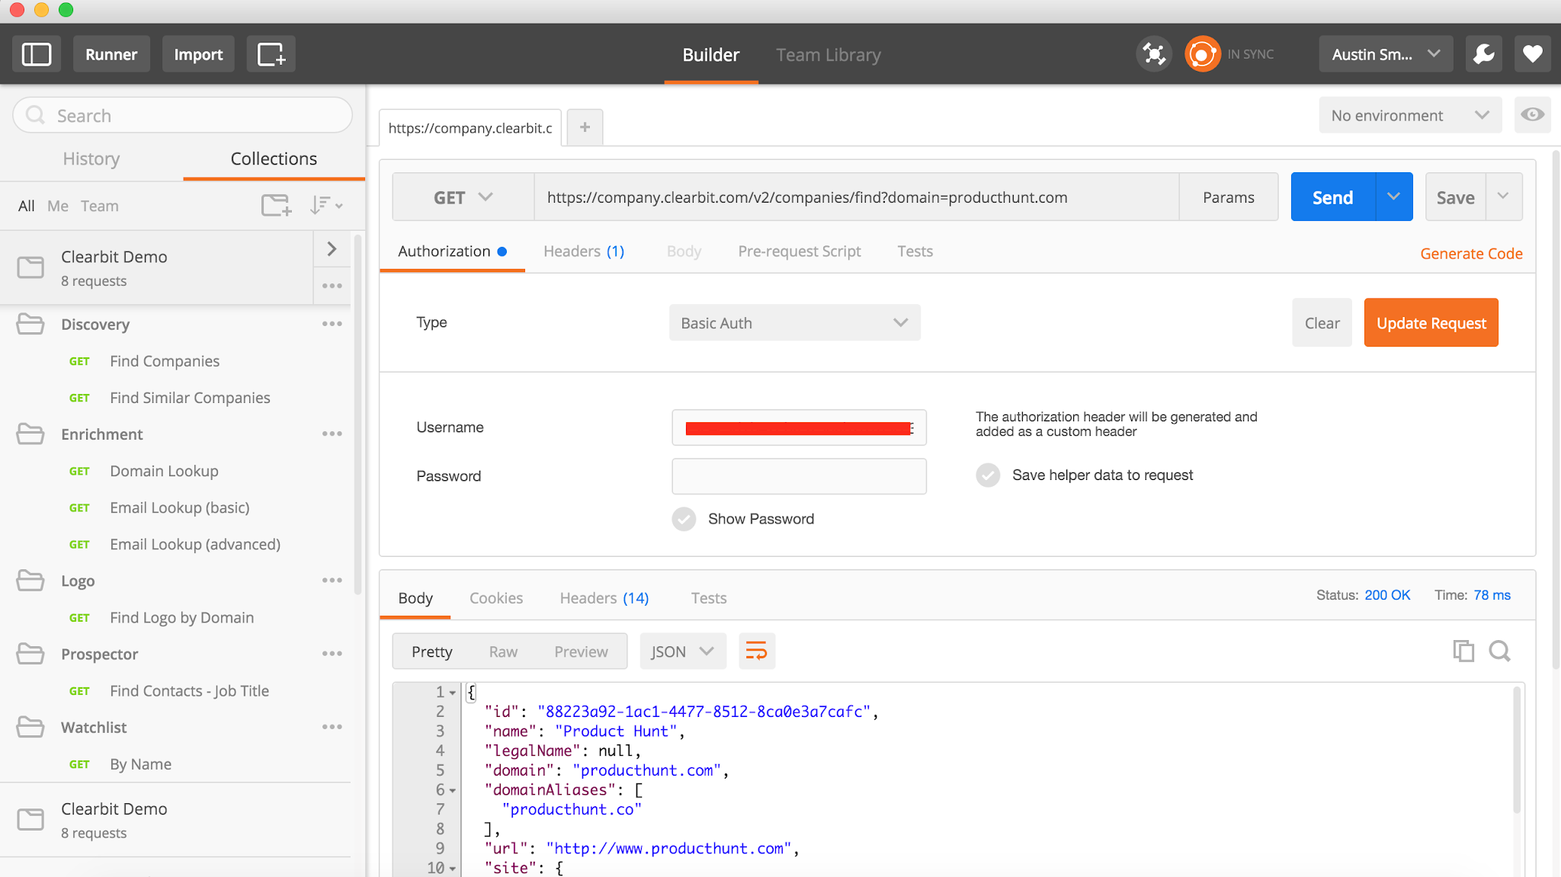
API Tools: Postman
Postman is a great tool when trying to dissect APIs made by others or test your own APIs. It offers a sleek user interface with which to make requests, without the hassle of writing lots of code.

Slide 31
Summary
7

Slide 32
Content
In this lecture we will learnt:
What application protocols are;
About clients and servers and how they interact via the HTTP protocol;
The tools we could use the make a request to the server.

Slide 33
Finis.

Slide 34
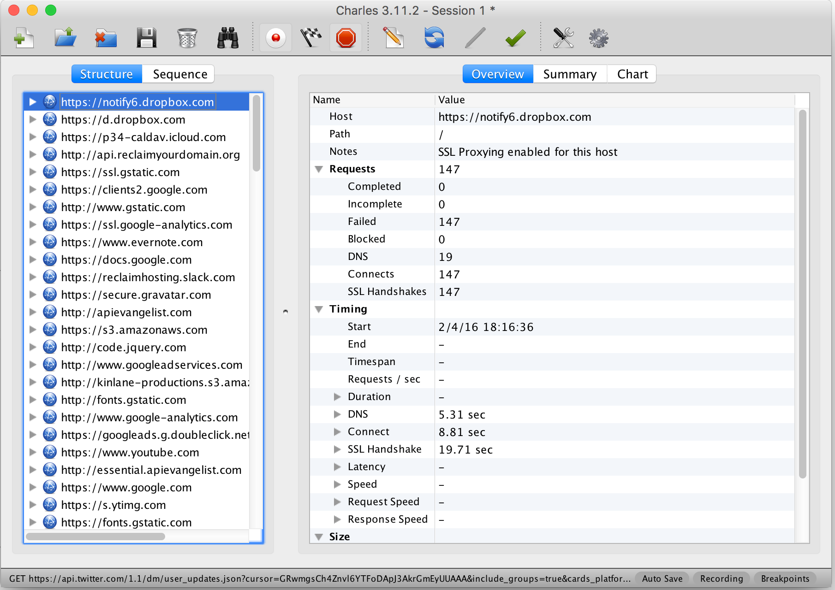
Appendix: API Tools: Charles Proxy
Charles is an HTTP proxy / HTTP monitor / Reverse Proxy that enables a developer to view all of the HTTP and SSL / HTTPS traffic between their machine and the Internet.

Slide 35
Appendix: OAuth Authentication
When you are consuming some external service via HTTP calls, servers want to take control over their service and may:
Limit the number of requests you can do, or ask you to pay for it
Not allow you to see data from other users in the systems.
For this reason, you must often authenticate yourself. One way to do so is by OAuth.
The oauth authentication is one of the most commonly used authentication protocols. It is used by many API providers and it is a well known public standard.

Slide 36
Appendix: OAuth Authentication
OAuth is simply a secure authorization protocol that works on top of HTTP.
When working with oauth, the service you are asking a REQUEST must provide you some authenticated credentials that normally have names like clientId or apiKey and apiSecret or apiToken or simply token.
These tokens will be used to authenticate instead of username+password.
The reason for that is that is not as secure to be transfering your password up and down as credentials.

